Slide 1
National Collaborative
VISION:
to integrate human rights into drug and alcohol policy development, implementation, monitoring, and evaluation leading to better outcomes for people affected by problem substance use.
National Care Service
Human Rights Bill

Slide 2
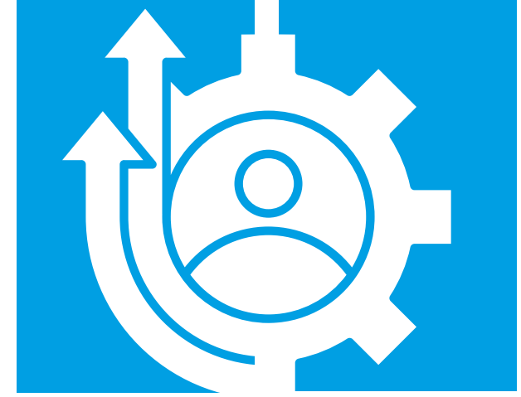
Purpose
1. To empower people affected by problem substance use to enable their voices – and, critically, their rights - to be acted upon in policy and decision-making concerning the design, delivery and regulation of drug and alcohol services at a national level.
2. To set out how the rights to be included in the forthcoming Human Rights Bill can be effectively implemented to improve the lives of people affected by problem substance use.

Slide 3
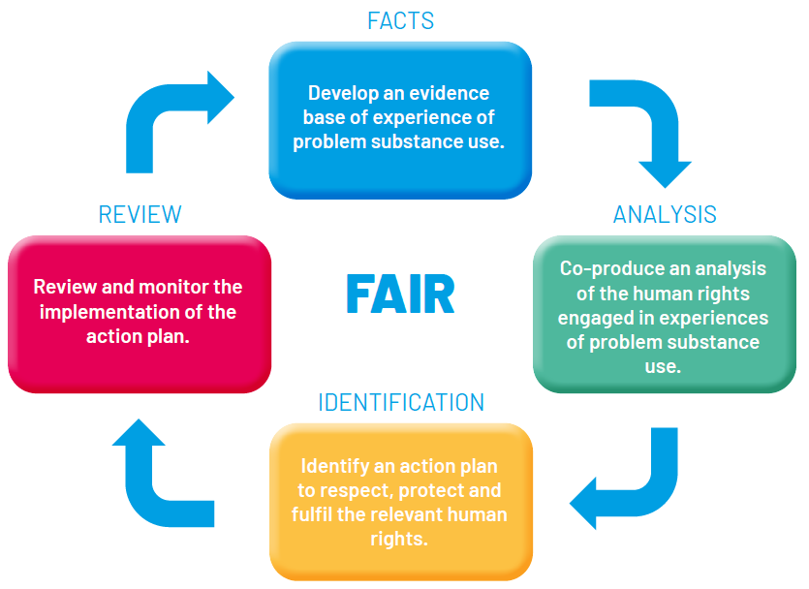
The Roadmap
Charter of Rights
Using FAIR model

Slide 4
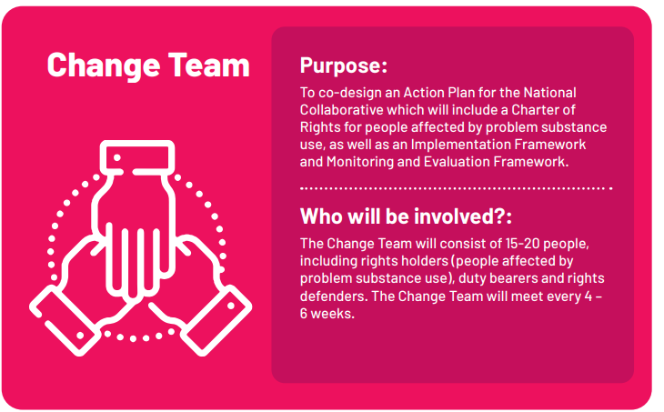

Slide 6
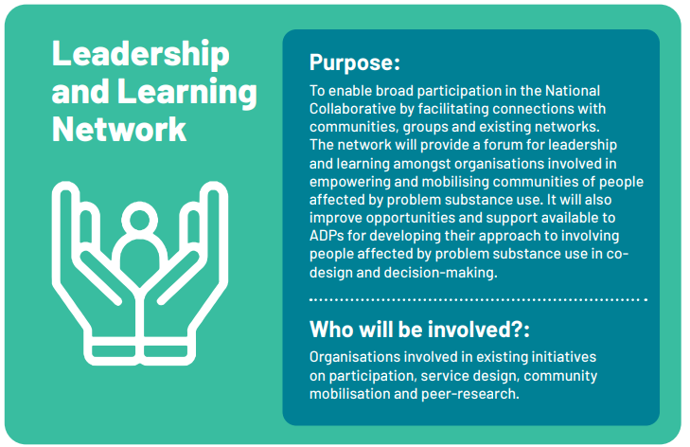

Slide 7
Evidence gathering around barriers to realising rights
The right to health (specifically healthcare) + right to life, right not to be subject to degrading treatment
2. The right to health (social determinants) + right to adequate standard of living
3. The right to participation
4. The right to private and family life
5. Criminal justice rights + Right to life, right not to be subject to degrading treatment

Slide 8
The right to health
The right to the highest attainable standard of physical and mental health means that drugs and alcohol services need to be designed, delivered and regulated to ensure….
Availability – e.g. choice of service in sufficient quantity and adequately funded
Accessibility – e.g. services are geographically and financially accessible
Acceptability – e.g. services are person-centred
Quality – e.g. services are evidence-based and trauma informed
Acceptability
Availability
Quality
Accessibility

Slide 9
From a families’ perspective,
1. Is the right to health fulfilled for people affected by problem substance use in Scotland? In terms of Availability, Accessibility, Acceptability, and Quality.
2. If not, in what specific ways is this right not fulfilled for people affected by problem substance use in Scotland?
3. What must change (in law, policy or practice) for this right to be fulfilled for people affected by problem substance use in Scotland?
Acceptability
Availability
Quality
Accessibility

Slide 10
From a families’ perspective,
4. Are health goods, services and facilities related to problem substance use delivered in a way that counters stigma and recognises the inherent dignity of every human person? If not, what are the issues, and what needs to change?
5. Are health goods, services and facilities related to problem substance use designed, implemented and assessed in a way that ensures those most affected are able to participate meaningfully (have their views heard and taken into account)? If not, what are the issues, and what needs to change?
6. When the above rights are breached, are people affected by problem substance use able to effectively challenge practices that breach these rights, and secure a remedy? If not, what are the issues, and what needs to change?
Acceptability
Availability
Quality
Accessibility

