Slide 1
Carers Rights

Slide 2
“ A carer is someone who provides unpaid support to a family member or friend. They may care for an older person, someone who is disabled, has a long-term illness, mental health problems or is affected by alcohol or drug use. Carers can be any age, from children to older people, and from every community and culture. Some carers may be disabled or have care needs themselves. They may be parents, spouses, grandparents, daughters, brothers, same sex partners, friends or neighbours. ”
What do we mean by carer?
Definition adapted from EPiC ( Equal Partners in Care)

Slide 3
Carers in Scotland
1 in 7 people in Scotland are Carers
Women aged 45-64 are more likely to provide unpaid care than any other demographic in Scotland
270,000 people in Scotland juggle a caring role alongside paid employment.
Only around 1 in 10 carers in Scotland are eligible for Carer's Allowance

Slide 4
What are some of the rights that carers in Scotland have.
What can carers do if their rights are being denied.
Today’s session

Slide 5
Can you name any rights that carers in Scotland have?

Slide 6
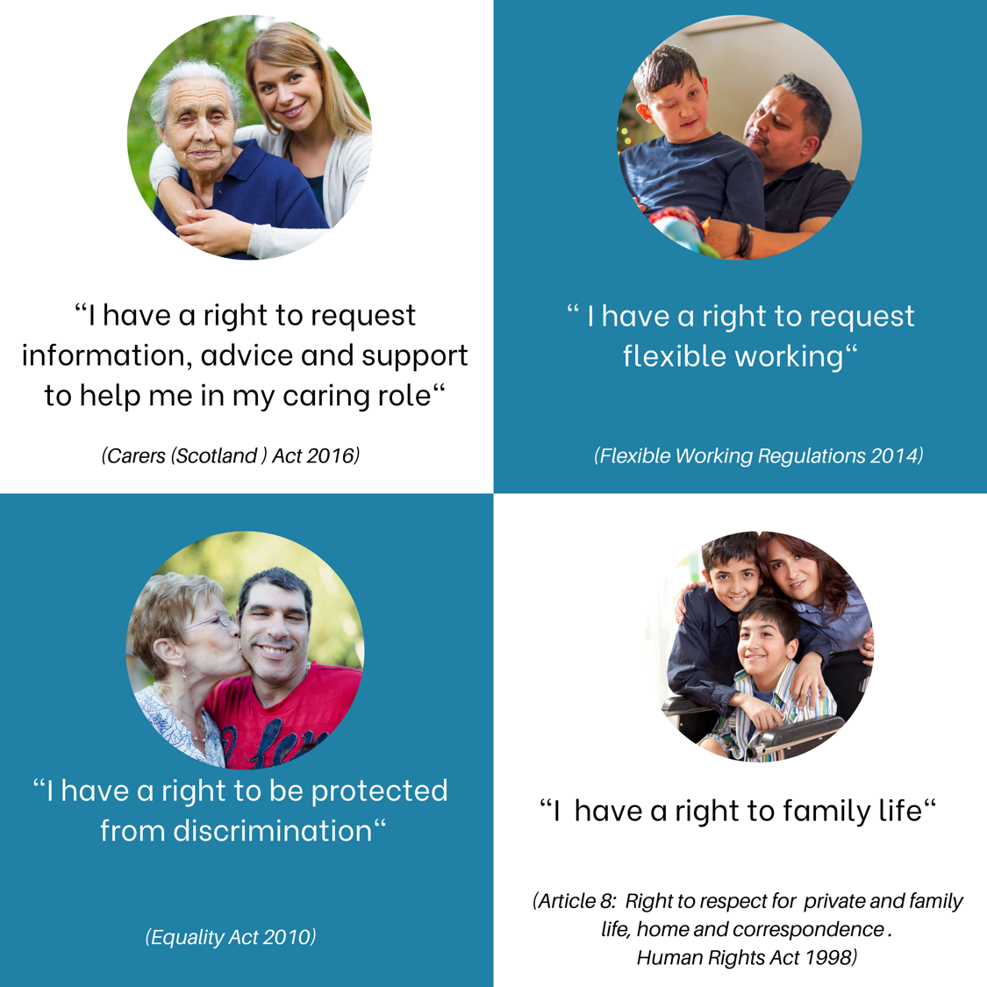
Carers in Scotland have a number of rights.

Slide 7
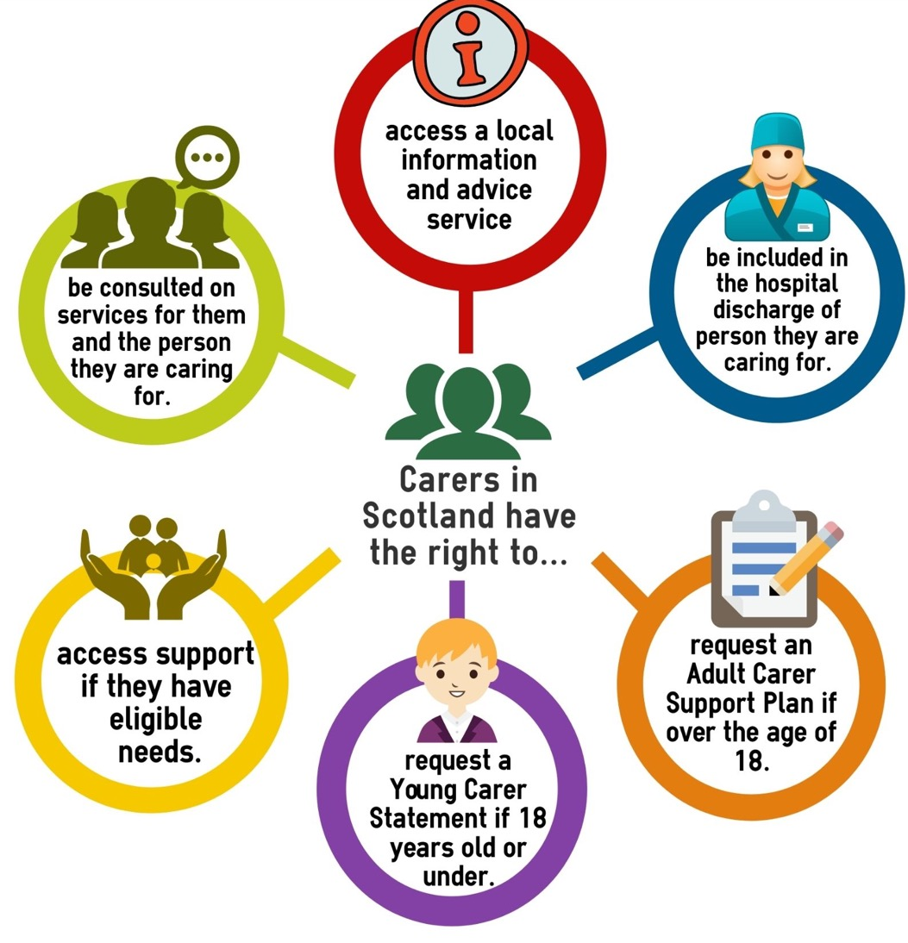
Carers have some specific rights under the Carers (Scotland) Act

Slide 8
Your local carers centre can provide you with a range of information, advice and support,
for example:
Carers have a right to access information, advice and support.
Information about your rights as a carer
Information about social security benefits
Requesting an adult carer support plan
Accessing a short break
Emotional support
Information about local services
Training for carers
Information about grants and funds
Informing local carer policy

Slide 9
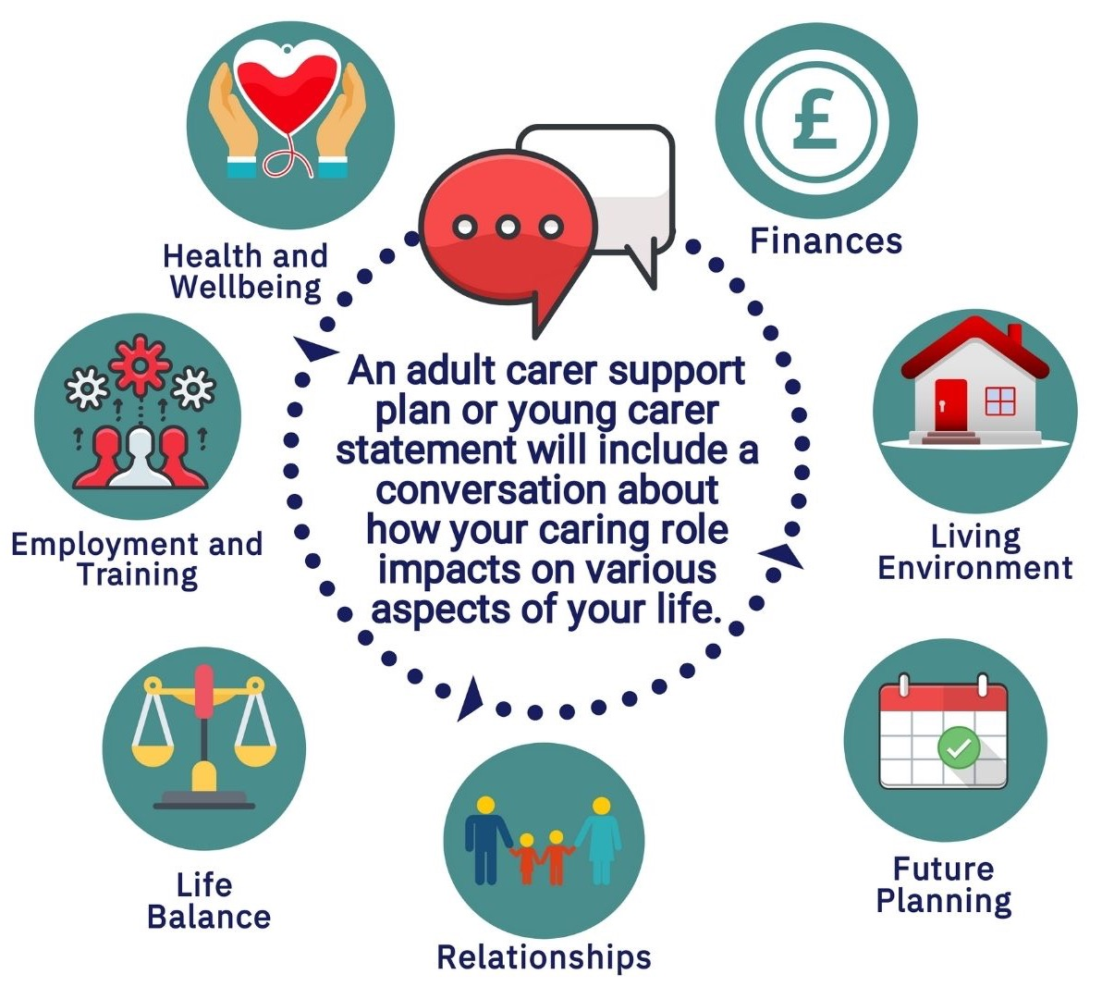
Carers have the right to request an adult carer support plan

Slide 10
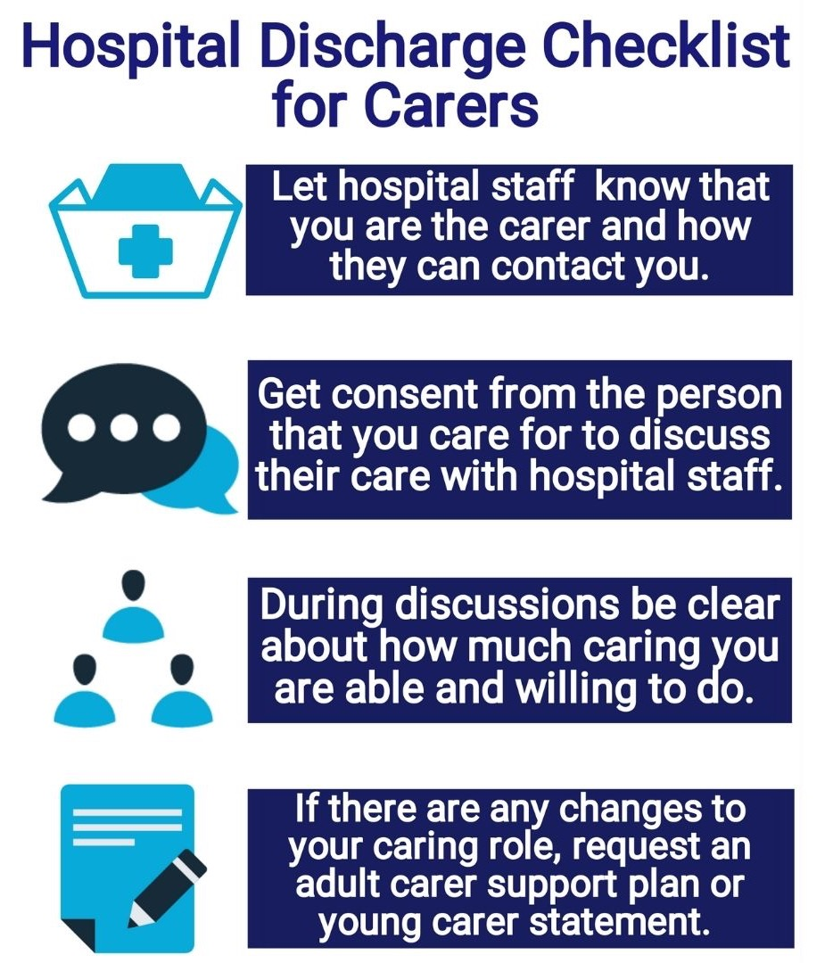
Carers have the right to be involved in discussions around hospital discharge for the person you care for.

Slide 11
There is currently no ‘Right to Respite’
However, under section 25 of the Carers (Scotland) Act, the local authority needs to consider whether support to a carer should include a break from caring.
A break from caring should be considered even if the carer does not meet the ‘eligibility threshold’
Right to respite/ Short break for carers?

Slide 12
Right to request flexible working
If worked for same employer for 26 weeks
If haven’t already made a flexible working request within the last 12 months.
Right to 18 weeks parental leave
If worked for same employer for 12 months and you’re responsible for a child under 18.
Its unpaid unless employer gives paid time off as contractual right.
Right to take ‘reasonable’ time off for emergencies
If you have to deal with emergencies involving a dependent.
Right to Carer Leave
Proposals for 5 days unpaid carer leave under consideration by UK Government.
Employment rights that carers have.

Slide 13
The public sector equality duty means local authorities and health boards have to consider how their policies or decisions affect people with the following protected characteristics:
The right to not be discriminated against when seeking support or services.
Age
Disability
Gender reassignment
Pregnancy and maternity
Marriage and civil partnership
Race
Religion or belief
Sex
Sexual Orientation
Equality Act 2010

Slide 14
Carers have the right not to be ‘Discriminated by Association’
This is where someone is treated less favourably because of their link or association with the protected characteristic of someone else (such as a carer’s link to the disabled person they are looking after).
Case Study
An employer disciplines an employee because they have taken time off to care for their disabled daughter.
The employer has not disciplined other workers who have had similar amounts of time off work.
This directly discriminates on the basis of the employee’s association with her daughter’s protected characteristic (i.e. disability).
Equality Act 2010

Slide 15
The Human Rights Act protects 16 rights.
The Human Rights Act 1998

Slide 16
Right to life
(Article 2)
Right not to be tortured in an inhuman or degrading way
(Article 3)
Right to be free from slavery or forced labour
(Article 4)
Right to marry and found a family
(Article 12)
Right to liberty
(Article5)
Right to a fair trial
(Article 6)
Right not to be punished for something which wasn’t against the law when you did it
(Article 7)
Right to respect for private and family life, home and correspondence
(Article 8)
Right to freedom of thought, conscience and religion
(Article 9)
Right to freedom of expression
(Article 10)
Right to freedom of assembly and association
(Article 11)
Right to not be discriminated against in relation to any of the human rights listed here
(Article 14)
Right to peaceful enjoyment of possessions
(Article 1, Protocol 1)
Right to education
(Article 2, Protocol 1)
Right to free elections
(Article 3, Protocol 1)
Abolition of the death penalty
(Article 1, Protocol 13)
What is the Human Rights Act 1998?

Slide 17
The right to life
Freedom from inhuman and degrading treatment
The right to respect for private and family life, home and correspondence
The right to be free from discrimination (also protected by Equality Act 2010)
Article 2
What does the Human Rights Act mean for Carers
Article 3
Article 8
Article 14

Slide 18
Support and
services
Regulations and Guidance
Other UK / Scottish Law (e.g. Carers (Scotland) Act)
Human Rights Act 1998
A carer’s Human Rights underpin all their rights as a carer
(and citizen!)

Slide 19
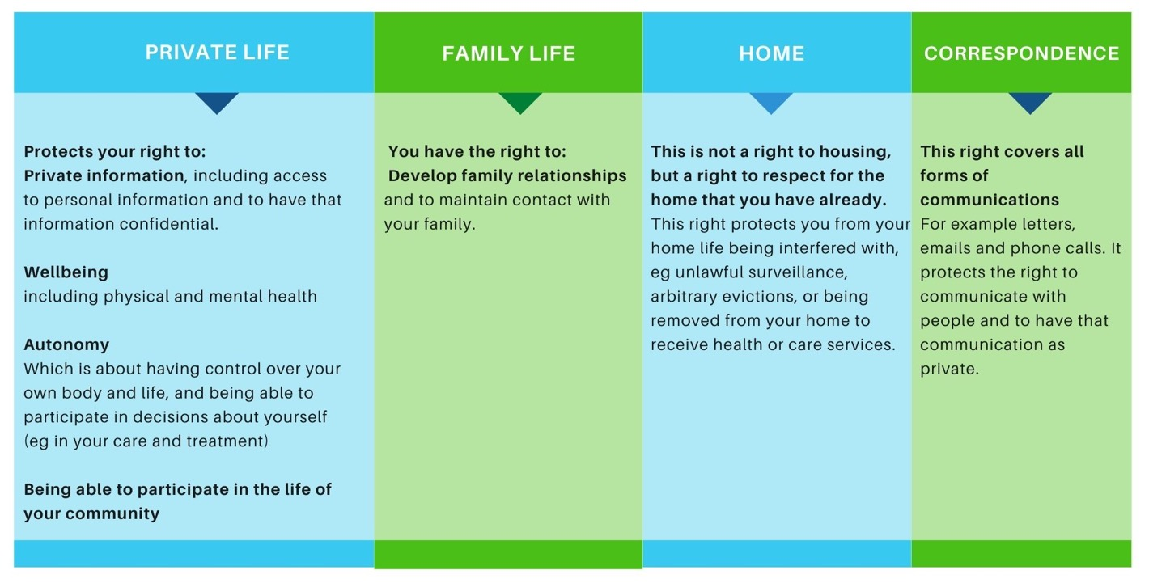
Article 8: Right to respect for private and family life, home and correspondence

Slide 20
If the local authority doesn’t provide the carer with proper support – for example with adequate breaks from caring and an appropriate assessment of the carers needs.
If the carer experiences poor mental health as a result of not being able to access medical treatment or not being able to recover fully from medical treatment due to their caring responsibilities.
If carer experiences poor wellbeing as a result of the physical and mental consequences of caring
If the carer experiences loneliness and isolation because caring means they may have few opportunities to participate in a social life.
If a carer experiences loss of privacy and family life because their loved one is moved into residential care against the wishes of the person or carer, or moved to a facility far from where the carer lives.
Examples of when a carer’s Right to Private and Family Life might be at risk

Slide 21
Case Study
Article 8:
Right private and family life
Helena, a disabled woman, was told by her occupational therapy department that she needed a special (‘profile’) bed. She was unable to leave her bed and this new arrangement would allow carers to give her bed baths. Helena requested a double bed so that she could continue to sleep next to her husband. The authority refused her request, even though she offered to pay the difference in cost between a single and double bed. A stalemate ensued for 18 months until the woman was advised by the Disability Law Centre to invoke her right to respect for private and family life. Within three hours of putting this argument to the authority, it found enough money to buy the whole of her double profile bed. Writing to Disability Now, the woman explained that ‘It has made a phenomenal difference to my life. If something similar happened in future, I would have no hesitation in using the [Human Rights Act] again’.
(Disability Now, June 2006, p 14.)

Slide 22
The right to respect for private and family life, home and correspondence can be restricted in certain circumstances. If a public official needs to interfere with this right, they must show that interference is:
Article 8 is not an absolute right
All three parts of this test must be met for a public official to justify interfering with your right to respect for private and family life, home and correspondence.

Slide 23
Article 3 covers treatment which causes you to experience extreme pain and suffering – either physical or mental.
Public authorities must not allow you to be treated in a way which causes you to suffer to this extent.
It is therefore important to make sure that you raise any potential human rights issues with a public authority.
If they are aware that this may be a risk – they have a duty to step in and take action.
Because this right is absolute, there can never be any justification for failing to take action.
Article 3:
Right to be free from inhuman and degrading treatment

Slide 24
Case Study
Article 3:
Right to be free from inhuman and degrading treatment
A parent carer is awaiting surgery for a serious back problem but continues to help her disabled daughter to shower, even though this puts the parent carer at risk of permanent back damage. The parent carer feels she has no choice because her local authority withdrew the two care staff who had previously provided help (after an assessment said it was too risky for the health of the care workers’ backs). All this could be avoided if the local authority authorise for an adapted shower to be installed, but unfortunately, the family have been on the waiting list over a year.

Slide 25
Article 2 gives you the right to have your life protected.
Public authorities must not take away your life
(apart from in very limited circumstances)
Public authorities must take reasonable steps to protect your life.
(where they know it may be in danger)
The right to life is an absolute right and the state has a strong duty to protect it.
Not being able to access essential medical treatment because of inadequate support services may in extreme circumstances affect your right to life.
Article 2: Right to Life

Slide 26
Case Study
Article 2: Right to Life
A 40 year old disabled man with complex health needs was having difficulty breathing. The doctor, who did not know this man properly, would not put him on a ventilator. He suggested to the man’s parents ( who were his primary carers) that perhaps it was their son’s “time”. The family told the doctor that they did not agree with his decision as their son had rallied round several times before from the “brink of death”. The parents were distraught at the doctor’s refusal to reconsider his decision. After trying everything else, the parents asked a support worker for help. The support worker advised them to challenge the doctor’s decision and ask whether he had considered their son’s right to life in coming to his decision. As a result of their challenge, the doctor re-assessed the decision and provided their son with a ventilator without the need for a second opinion. Two months later, the man was alive and well and off the ventilator.

Slide 27
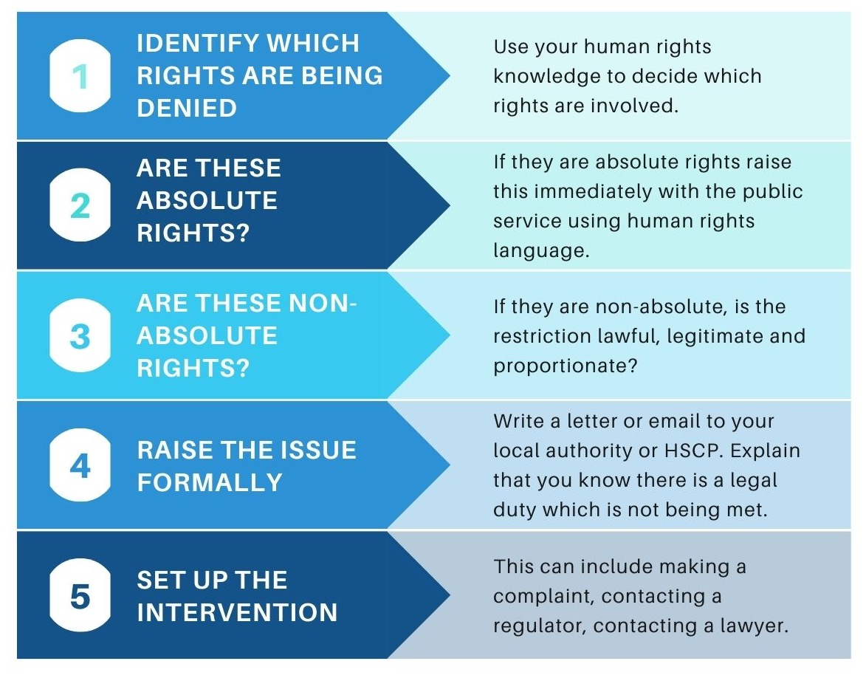
What can you do if you think you are being denied your rights?

Slide 28
Carers Charter (summary of rights that carers have under Carers (Scotland) Act)
Your rights in work (useful factsheet on employments rights for carers)
Carers and the Equality Act (summary of the Equality Act and what it means for carers)
Pocket Guide to Human Rights for Carer (an excellent resource to understand how the Human Rights Act applies to carers)
Resources

Slide 29
Coalition website
For information and resources about carer rights and policy, our meetings, and becoming a member.
Coalition Facebook Page
For up to date news and announcements for carers in Scotland
Shubhanna Hussain-Ahmed
Partnership Development Officer
Coalition of Carers in Scotland: Shubhanna@carersnet.org
Getting in touch

