Slide 1
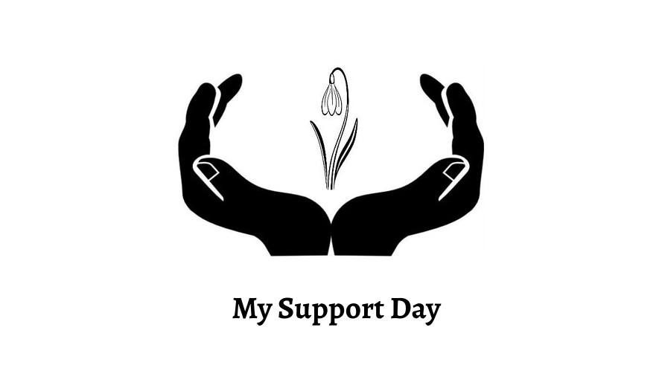
My Support Day Yes We Can! Embed a Whole Family Approach.

Slide 2
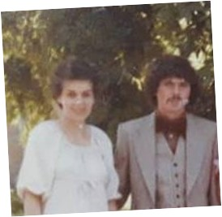
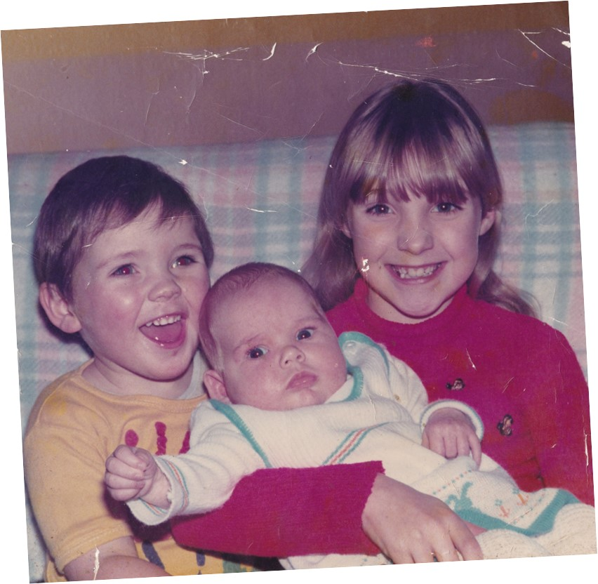
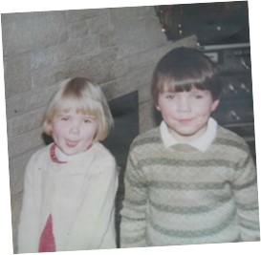
Lived experience set the foundations for change in our community.

Slide 4
One small pot of funding …. One large step to family recovery in South Lanarkshire.
My Support Day (MSD) received their first pot of funding from CORRA Family Recovery Initiative Funding (FRIF) in 2019.
This enabled for staff training in Community Reinforcement Approach and Family Training (C.R.A.F.T) and to hire a room for 2 hrs. every week for 7 months in East Kilbride.
MSD became part of the working group for Scottish government on developing the new strategy for the Whole Family Approach.

Slide 5
Collaborative working starts to make tracks for families.
South Lanarkshire ADP and SFAD were moving forward on a scoping exercise to identify the needs of family support and a Whole Family Approach through out SL.
The outcome was that there was a need for both within the community of South Lanarkshire as there was little to no support for families in South Lanarkshire.
The outcome was for SFAD and MSD to collaborate to deliver the service All In The Family within the 4 Beacons throughout South Lanarkshire . This was to embed a Whole Family Approach throughout South Lanarkshire.
From July 2020 – July 2022 we had supported
172 Individuals ran 416 family support groups and indirectly supported 444 children.

Slide 6
What Our Service Offers.
Who We Support.
What Support Do We Offer?
What new work streams are coming?
Families and individuals that have been affected by someone else’s substance use.
One to One Support
Support Groups
Family Saturdays
Drug and Alcohols educational sessions.
Naloxone Drop In sessions.
C.R.A.F.T sessions.
Family Inclusive events.
Training on WFA and FIP.
New Family Outreach service.
Homework Club .
FREE – Family Recovery Everyone Everywhere.

Slide 7
What now?
In partnership with Liber8 we are the new commission service in South Lanarkshire for the whole family approach.
My Support Day in partnership between Liber8 will deliver the service FREE – Family Recovery Everyone Everywhere. This service is based across South Lanarkshire to access one-to-one support, group support, learning and development and events for the whole family. This service will also offer counselling, mediation and therapeutic services to individuals using the service which can tailor their support to suit their needs.

Slide 9
What are The Beacons?
The Beacons are a set of 4 Recovery Hubs based in each of the 4 localities of South Lanarkshire; Hamilton, Cam/Glen, Clydesdale and East Kilbride. The Beacons are hosted by Liber8, contracted by South Lanarkshire’s Alcohol & Drug Partnership.
The purpose of The Beacons is to ensure that there is visible treatment and recovery embedded into local communities. Using assertive outreach, non-clinical settings and lived experience peers, our aim is to reach individuals who aren’t currently engaging with service provision.
Our welcoming and trauma-informed healing environment helps re-integrate those in recovery into the local community. Each person's experience here is person-centred. This means that they decide what they want to get from their time at the Beacons - whether they’re looking to share experiences in a Recovery Group, receive family support, or meet new people at a social event, explore volunteer opportunities, build positive support networks.

Slide 10
South Lanarkshire: Recovery
Equitable across South Lanarkshire localities
Unique Model- non-traditional and non-clinical
Trauma-informed and promoting psychological well-being
Embed the values of welcome, healing, compassion and empathy.
Upskill people with lived and living experience- : Beacons 1st Responders
Whole family approaches
SL ADP
Consultation

Slide 11
Aim: Visible Recovery in South Lanarkshire
The ethos behind VR is to share lived experience and to reinforce the message that recovery is possible.
An increased recovery presence within communities maximises engagement of treatment services and recovery initiatives​
Reduces stigma around problematic substance use and poor mental health within wider communities​ and the general public
Allows us to show a different side to recovery - a side which sees people helping people to rebuild lives afresh, with new friends, stronger family links, more opportunities for self-development and better prospects​
To ensure a Whole Family Approach is implemented across all localities in South Lanarkshire

Slide 12
The Beacons: 4 South Lanarkshire Localities
Blantyre / Hamilton Beacon
Launch Nov 2019
Lanark / Clydesdale Beacons
Opened March 2020
1
2
Liber8 Lanarkshire Host Organisation
East Kilbride
Beacon-
Opened March 2023
Cambuslang/ Rutherglen Beacon. Opened Sept 2020
4
3

Slide 13
Family Beacons Model Programme of Activity
1. Blantyre.
2. Lanark.
Family Liaison Worker based in all Beacons.
Joint Events throughout the year.
Naloxone Drop in training
Recovery Oriented System of Care (ROSC)
Training
Homework Club
Family Support Meetings
Family Support Meetings in all Beacons.
Family
Saturday's/ Recovery Cafe.
Phycology
Support -
Group/ 1:1
Shared resource opportunities.
All In The Family Launch.
Family Steer Group.
4. East Kilbride.
Family Support Group's
1:1 support
3. Cambuslang.
WFA and FIP
Training.
MAT Standards training jointly delivered by Beacons and MSD
New
Family Service
FREE
Launched
Family First Responder's
Training and development open and closed sessions.
C.R.A.F.T
Sessions.
Joint Family and lived experience open meeting.
Come Dine With Me
Whole Family National Strategy Official Launch.

Slide 14
Blantyre /
Hamilton
Lanark /
Clydesdale
Cambuslang
/ Rutherglen
East Kilbride
Activities & Opportunities
Activities & Opportunities
Activities & Opportunities
Activities & Opportunities
Recovery Meetings
Family Support Meetings
AA, CA, & Al-anon groups
Walking Group
Gardening Project
Arts & Crafts Group
Saoirse
Women's Groups
Women's Justice Hub
Lived Experience driven programme
NEW Family Service FREE launched in East Kilbride Beacon
Recovery Meetings
Training opportunities
Locality based events
Specific specialist groups
Recovery Meetings
Family Support Meetings
Social afternoons
Social Evenings
Walking Group
Boxercise & Football
Recovery Meetings
Family Support Meetings
Psychological and psychosocial training,
Assorted Training Opportunities,
Psychological and psychosocial training,
Assorted Training Opportunities,
Arts & Crafts Group
Men’s & Women's Groups
Psychological , psychosocial & assorted training opportunities

Slide 15
Recovery Orientated System Of Care
ROSC is a coordinated network of community based services and support that is person-centred and builds on strengths and resilience of individuals, Families and communities…….It recognises there are many pathways to recovery, including treatment (which at times include hospital and/or residential based treatment interventions), mutual aid groups, faith based recovery, cultural recovery, natural recovery, medication-assisted recovery, amongst others…..it offers choice by providing a flexible menu of services and supports designed to meet each individual’s specific needs….It builds on assets rather than emphasising deficits and pathologies……(Bill White)

Slide 16
ROSC/Partnerships
CARe'S
GIVIT
REACHOUT (TPS)
HEALTH IMPROVEMENT
CRIMINAL JUSTICE
CAB
SKILLS DEVELOPMENT SCOTLAND
VENTURE TRUST
NEW LANARK COLLEGE
SOCIAL WORK (EARLY INTERVENTION)
SAOIRSE
YOU TURN
ASDA
My Support Day
ALANON

Slide 17
The Beacons
info@thebeacons.org.uk
admin@thebeacons.org.uk
www.thebeacons.org.uk
01698 755 926

Slide 19
Yes we can! How to build and embed a Whole Family Approach in practice
Rosie Welsh

Slide 20
“No man is an island entire of itself” John Donne. 1623

Slide 21
Setting The Scene
South Lanarkshire Alcohol and Drug Partnership (SLADP) established in 2017
SLADP want to ensure South Lanarkshire is a place where:
All people have the right to a long, purposeful, meaningful life and for this life to be free from the harms of alcohol and drugs.
Individuals and families are treated with dignity and respect.
Individuals, families and communities are included and fully supported to find their own unique concept and working model of recovery.

Slide 22
The Beginning
Scottish government directive 2018
Funding released
Consultation- Stakeholders, grass roots activists
Consultation Outcome: There was a transformational change required – developing systems (whole population approach) that embrace a blend of strategies addressing mental health and addictions, problematic substance use, and based very much on trauma informed practice and a whole family approach.

Slide 23
Starting the Journey
SL Recovery Beacons Established.
My Support Day
CORRA/SLADP Funding
COVID

Slide 24
Moving on – Family Recovery
Whole family approach framework
Funding
Family members consultations
Blueprint event
Co-production

Slide 25
Blueprint – Co-Production
Residential Rehabilitation
Support and guidance were recognised as being an essential need in order to achieve a whole family approach to recovery. To achieve this families, need to be fully informed and involved every step of the way.
Equity of gender
Historically in South Lanarkshire more female than male family members will engage with family support services. As a result, the need to provide a focus on engaging families; in particular, the male members of the family to support and signpost to the wider community family support networks was identified.

Slide 26
Mediation
Family members expressed the need to consider/embed mediation as part of service delivery to bring the family together where fragmentation has occurred as a result of substance use. The use of advocacy services requires to be considered within this approach as well.
Website for families
Families who have been impacted by their loved ones’ substance use expressed a difficulty accessing support/information online with a South Lanarkshire focus.
Prison
Support for families who have been impacted by their loved ones’ substance use which has resulted in their loved one receiving a custodial sentence. Families need support and guidance as to treatment/recovery options available on their loved ones’ liberation.

Slide 27
Results are In!
Tender
Interview
Award
Implementation
The Family Recovery Everywhere for Everyone(FREE)

Slide 28
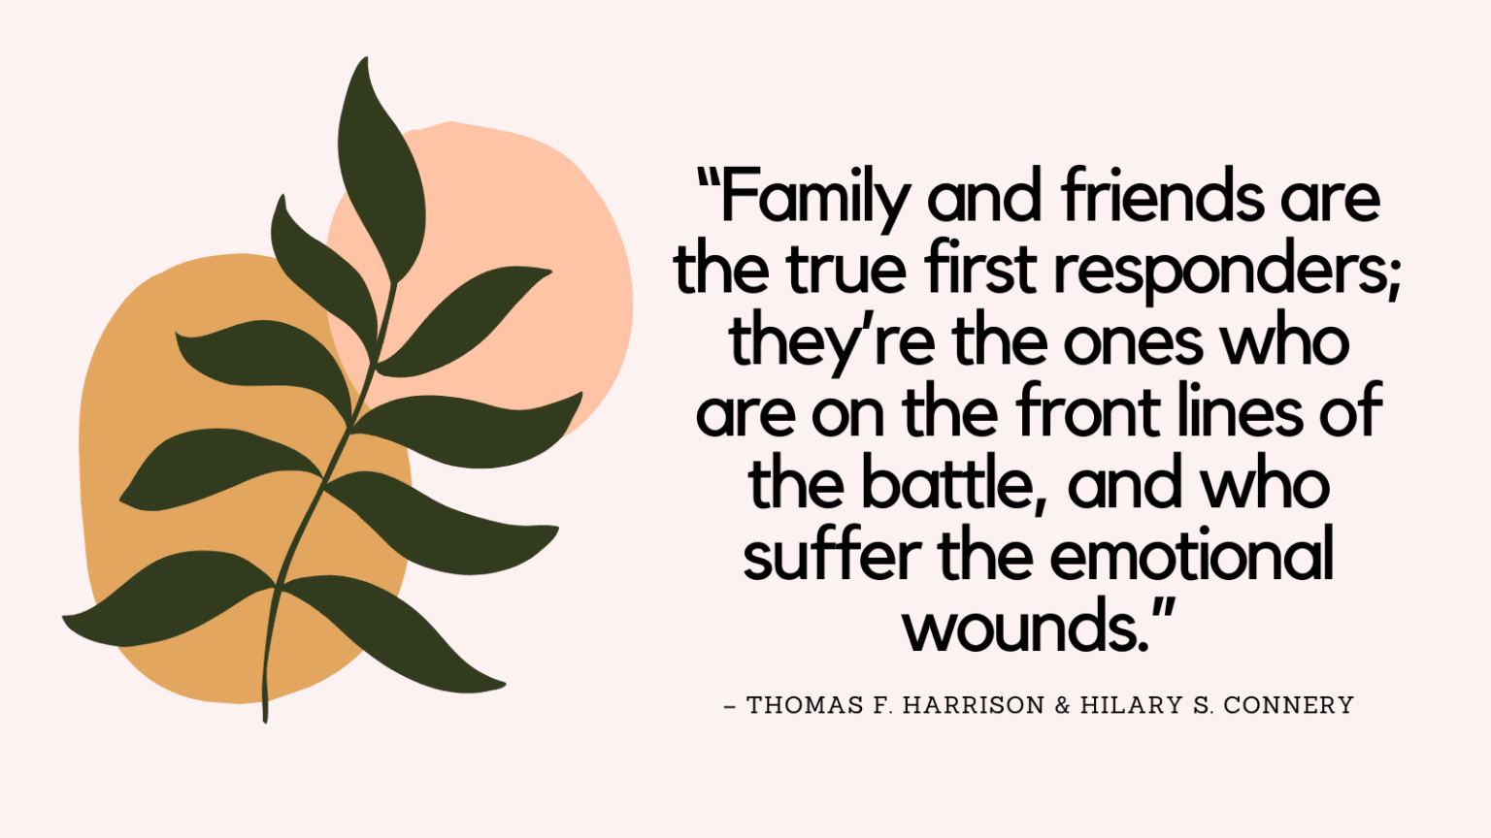
“We honour ourselves when we speak out for recovery. We show the world that recovery matters because it brings hope and peace into the lives of individuals and their loved ones.” ~ Beth Wilson

Slide 29
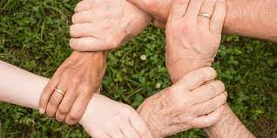
THANK YOU

Slide 30
Family First Responders
Key Points
“Family recovery should be visible…”
( My Support Day - Family First Responder)
Peer Support
Knowledge
Education
Empowering the community.

Slide 31
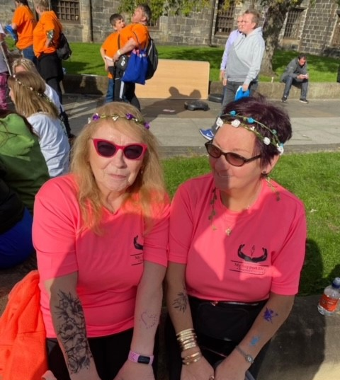
Meet our Family First Responders.

Slide 32
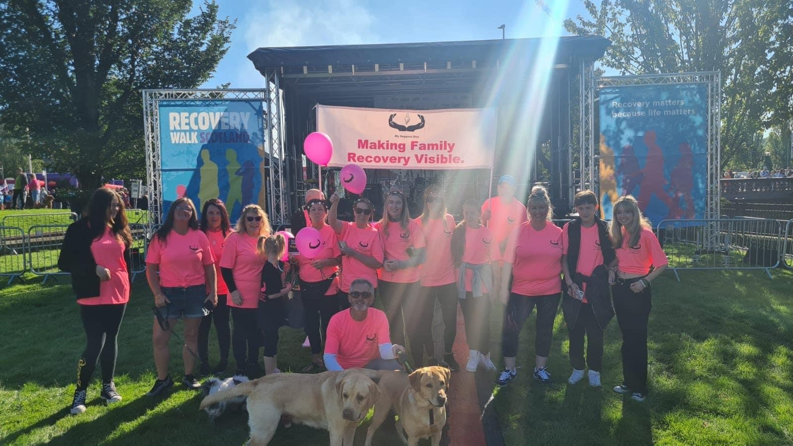
Questions & answers
Invite questions from the audience
We are making Family Recovery visible in our community how will you make it visible in yours?

