Slide 1
Wellbeing Treasure Chest Make some time for you…

Slide 2
Create space for you to reflect and focus on what you can control for your overall wellbeing
Provide practical ideas that are easy to implement
Inspire you to do ONE thing differently – a little and often!

Slide 3
On a scale of 1-10 (1 being least 10 being best) how are your energy levels right now?

Slide 4
My Story
House of Four Rooms
Positive Environment & Morning Routine
Creating Your Wellbeing Treasure Chest

Slide 5
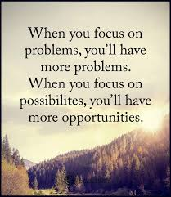
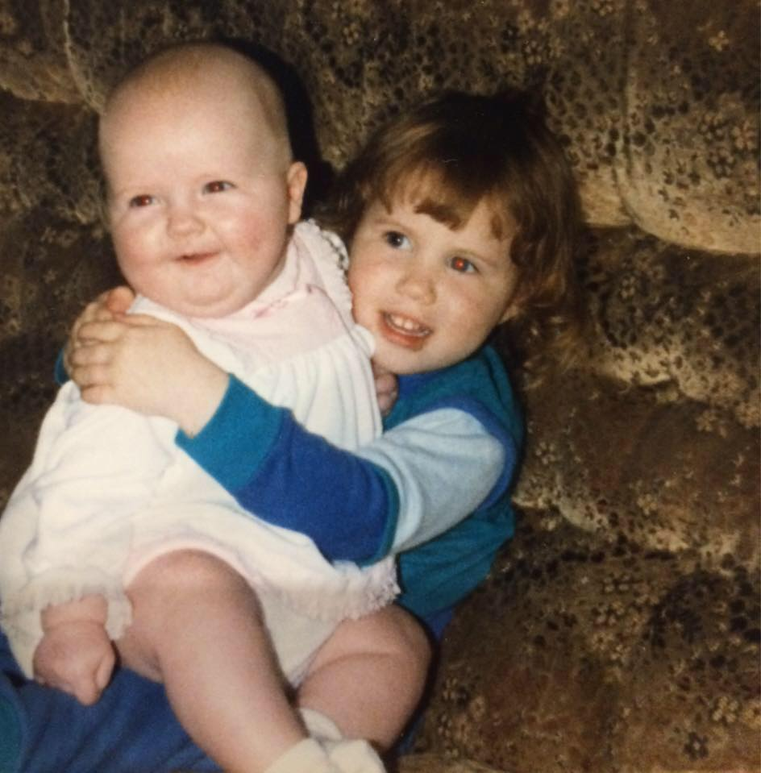
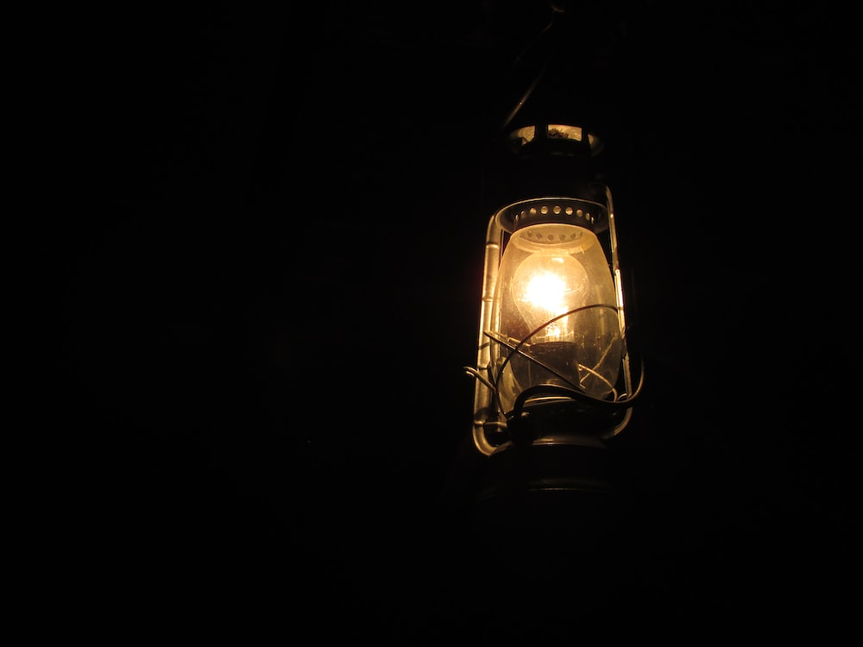
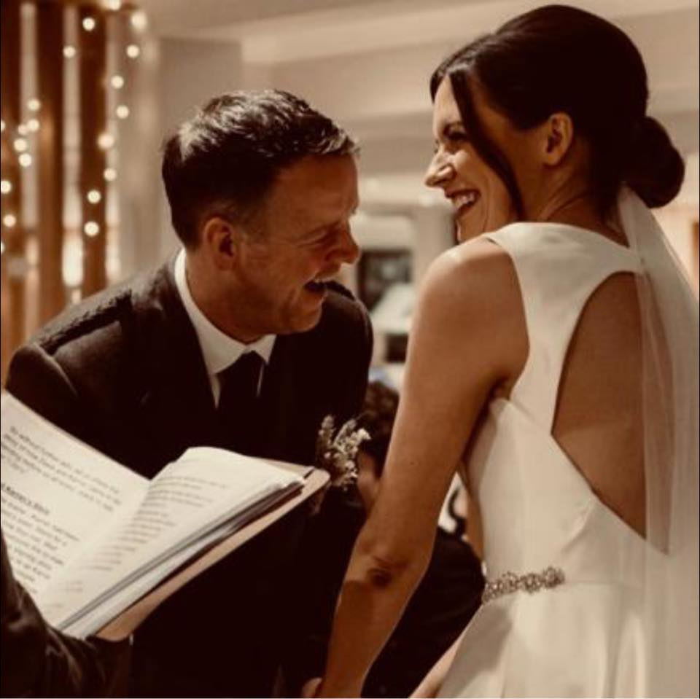
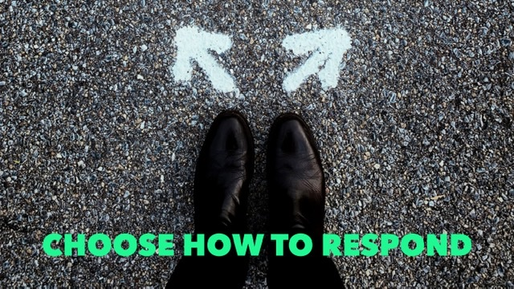
My Story

Slide 6
House of Four Rooms
Indian proverb that says that “everyone is a house with four rooms, a physical, a mental, an emotional and a spiritual. Most of us tend to live in one room most of the time but, unless we go into every room every day, even if only to keep it aired, we are not a complete person.”

Slide 7
House of Four Rooms
MENTAL
EMOTIONAL
PHYSICAL
SPIRITUAL
Notes:
In which of these rooms do you spend most time?
What about least time?? I am going to share some tips and ideas about how you can air each of the four rooms
They are all interconnected

Slide 8
House Of Four Rooms
IQ (Mental)
Learning new things
Reading
Exercise and breathing to oxygenate the brain
Develop knowledge & expertise
Setting yourself a stretch goal
Top tip: Try learning something new or doing that thing you have always wanted to do
EQ (Emotional)
Showing compassion and kindness
Actively listening to others
Becoming aware of inner self talk
Connecting with family
Top tip: Develop positive self talk through questions
PQ (Physical)
Rest and sleep
Moderation v Indulgence – Mindful eating
What exercise do you enjoy?
Yoga
Tai Chi
Dancing/Zumba
Walking outside in nature
Top tip: Change your state by moving your body
SQ (Spiritual)
Explore mindfulness
Meditate/quieten your mind
Reading personal development books
Practicing Gratitude
Journal
Giving to others
Top tip: Become more mindful in your day to day tasks
Notes:
What ideas do you think you will try or revisit?
We spend so much time trying to attain the perfect balance is, the truth is we have preferences for where we feel comfortable and where we want to spend our time. However, if we can at least visit the other rooms once a day it will bring about a greater sense of wellbeing and happiness.
For me at the moment I am drawn to getting outdoors as much as I can in nature and the fresh air. Relate to the recommendation in mental room where exercise brings about clarity of thoughts, whilst a very different way of bringing about that clarity is through meditation and mindfulness. Being more aware of breath, body and thoughts has brought a real sense of calmness. It’s free and I would encourage everyone to try it, it can bring about real clarity of thoughts and calms, proven to reduce anxiety and I think a lot of people could do with that. I have a list of great meditations and ideas re mindfulness. Would anyone like me to send these over as a follow up?
What room are you going to air a little more often?

Slide 9
Let’s step into each room…

Slide 10
Who can relate?

Slide 11
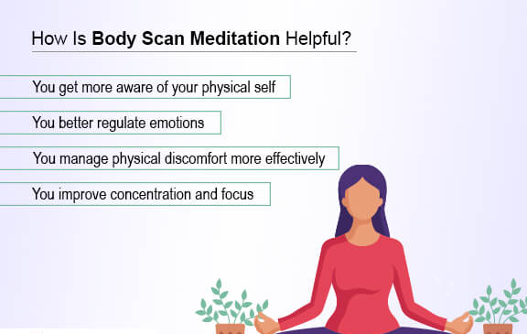
SPIRITUAL
Body Scan

Slide 12
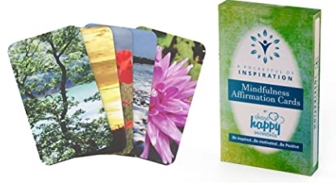
Choose a card with an image you are drawn to…
Reflect on the words of the card and write down anything that is relevant for you…

Slide 13
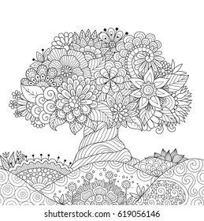
Art Attack Time…
Time to get creative…colour in one of the images at your table!

Slide 14
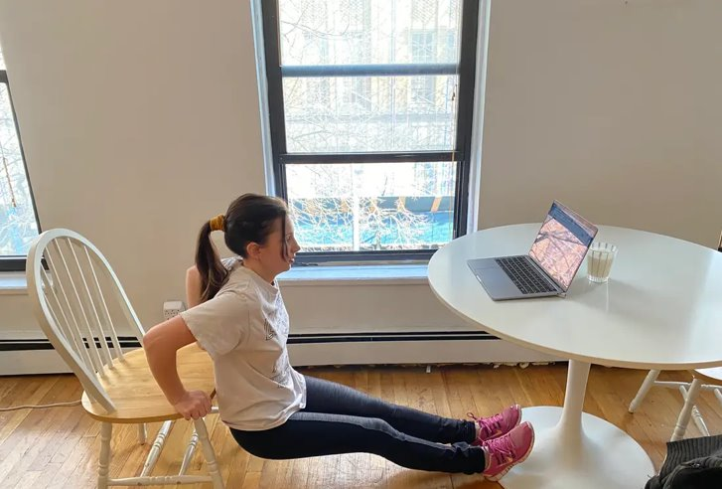
PHYSICAL

Slide 15
EMOTIONAL
Notes:
Using an elastic band to become aware of when talking negatively, ping the elastic band and ask yourself a question about what could you do to positively influence the situation, how you feel, what next step could you take?

Slide 16
MENTAL
Spending 10 minutes a day learning
What do you want to learn, what resources do you need?
Why do you want to do it?
When will you do it? (Day/time)
Where? (What room)
How will you record progress? Measure success?

Slide 17
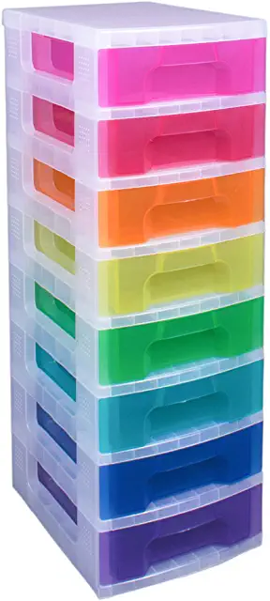
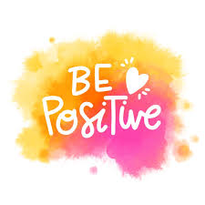
Positive Environment
Notes:
Organising your space – even if it’s at home in an open plan space – colourful drawers can keep it nice and tidy
Scents and smells can be relaxing
Music can energise and uplift
Keep yourself hydrated and water helps your concentration levels
Let in the fresh air and get outside
Having a positive focus and nice photos/pictures to look at can inspire

Slide 18
Starting Your Day: Healthy Morning Routine
Thankfulness
Insight
Meditation
Exercise

Slide 19
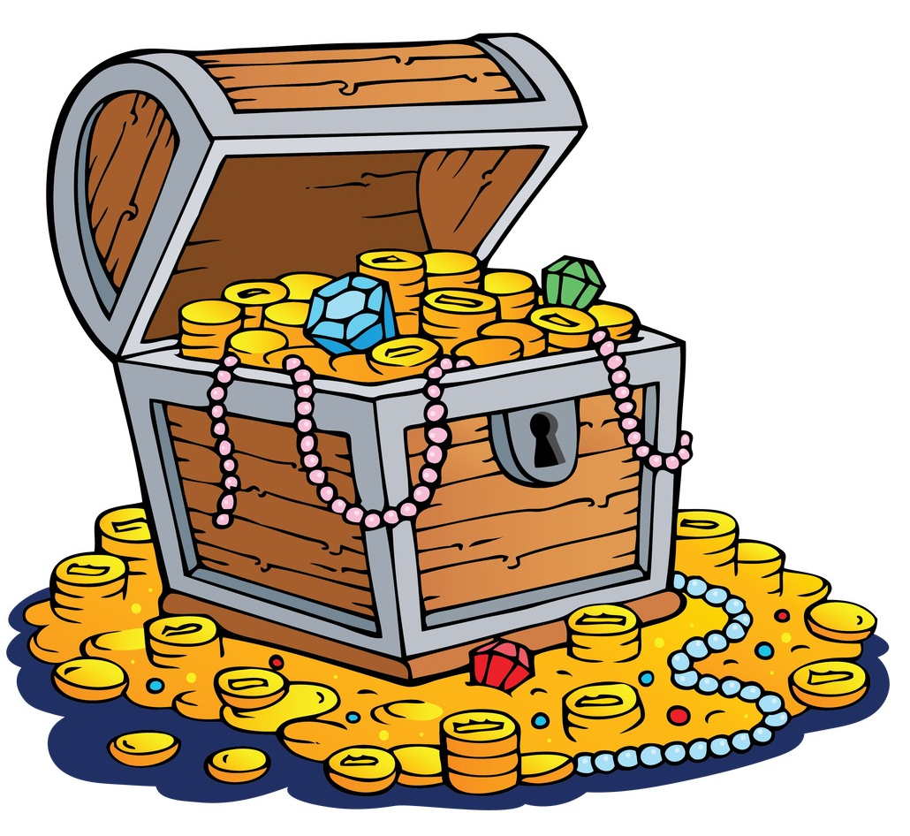
Creating your Wellbeing Treasure Chest…
Your morning routine
Asking for support
Inner self-talk
Reducing the negativity and mood hoover time
Bringing the banter
Exercise
Getting fresh air
Taking time to relax
BREATHE!
Draw a treasure chest and note what things you want to incorporate into your wellbeing treasure chest…
The self care tracker might help you with some ideas

Slide 20
On a scale of 1-10 (1 being least 10 being best) how are your energy levels right now?

